Slide 1

NETWORK PORT SCANNER GUI
Ruchita Maaran
STU67d828c8ccc881742219464
Saveetha Institute of Medical and Technical Sciences

Slide 2

PROBLEM STATEMENT
Network administrators and developers need a simple, fast way to identify open TCP ports on target hosts.
Existing tools like Nmap require CLI expertise with complex flag syntax, lack real-time visual feedback, and have steep learning curves.
There's a gap for a lightweight, GUI-based alternative that requires zero configuration and works cross-platform without external dependencies.

Slide 3
PROJECT DESCRIPTION
Network Port Scanner GUI is a Python-based graphical application that performs TCP port scanning with a focus on simplicity and speed.
It provides a 3-field interface (target, start port, end port), uses multi-threading to scan up to 500 ports concurrently, automatically identifies common services (FTP, SSH, HTTP, MySQL, RDP, etc.), displays real-time progress with a live progress bar, allows users to stop scans gracefully, and exports results to a .txt file.
The entire application runs cross-platform (Windows, macOS, Linux) with zero third-party dependencies.

Slide 4

WHO ARE THE END USERS?
1. System Administrators - Verify services are running on expected ports
2. Network Engineers - Troubleshoot connectivity issues and audit port availability
3. Cybersecurity Professionals - Perform vulnerability assessments on authorized systems
4. Software Developers - Check if local services (localhost:3000, 5432, etc.) are listening
5. IT Support / Help Desk - Diagnose port connectivity issues for end users
6. Students & Learners - Understand port scanning concepts without complex tools

Slide 5

TECHNOLOGY USED
- Python 3.7+ (primary language, cross-platform)
- Tkinter (GUI framework, included in Python standard library)
- Socket Library (TCP connection testing via socket.connect_ex())
- Threading Library (multi-threaded port scanning with semaphore-based concurrency)
- Queue Library (thread-safe communication between scanner and UI)
Standard Library Modules:
- socket (TCP operations, DNS resolution)
- threading (multi-threaded scanning, semaphore for concurrency limits)
- queue (thread-safe result passing)
- time (elapsed time tracking)
- tkinter & tkinter.ttk (GUI widgets)
- tkinter.messagebox (dialog boxes)
- tkinter.filedialog (file save dialog)

Slide 6
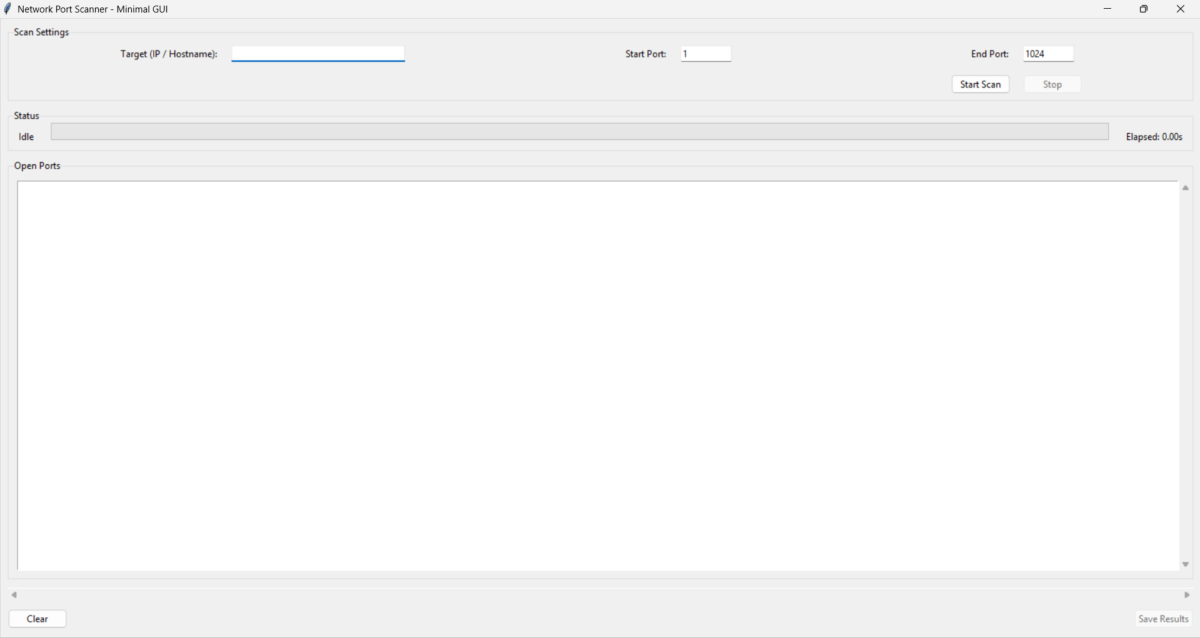
RESULTS

Slide 7
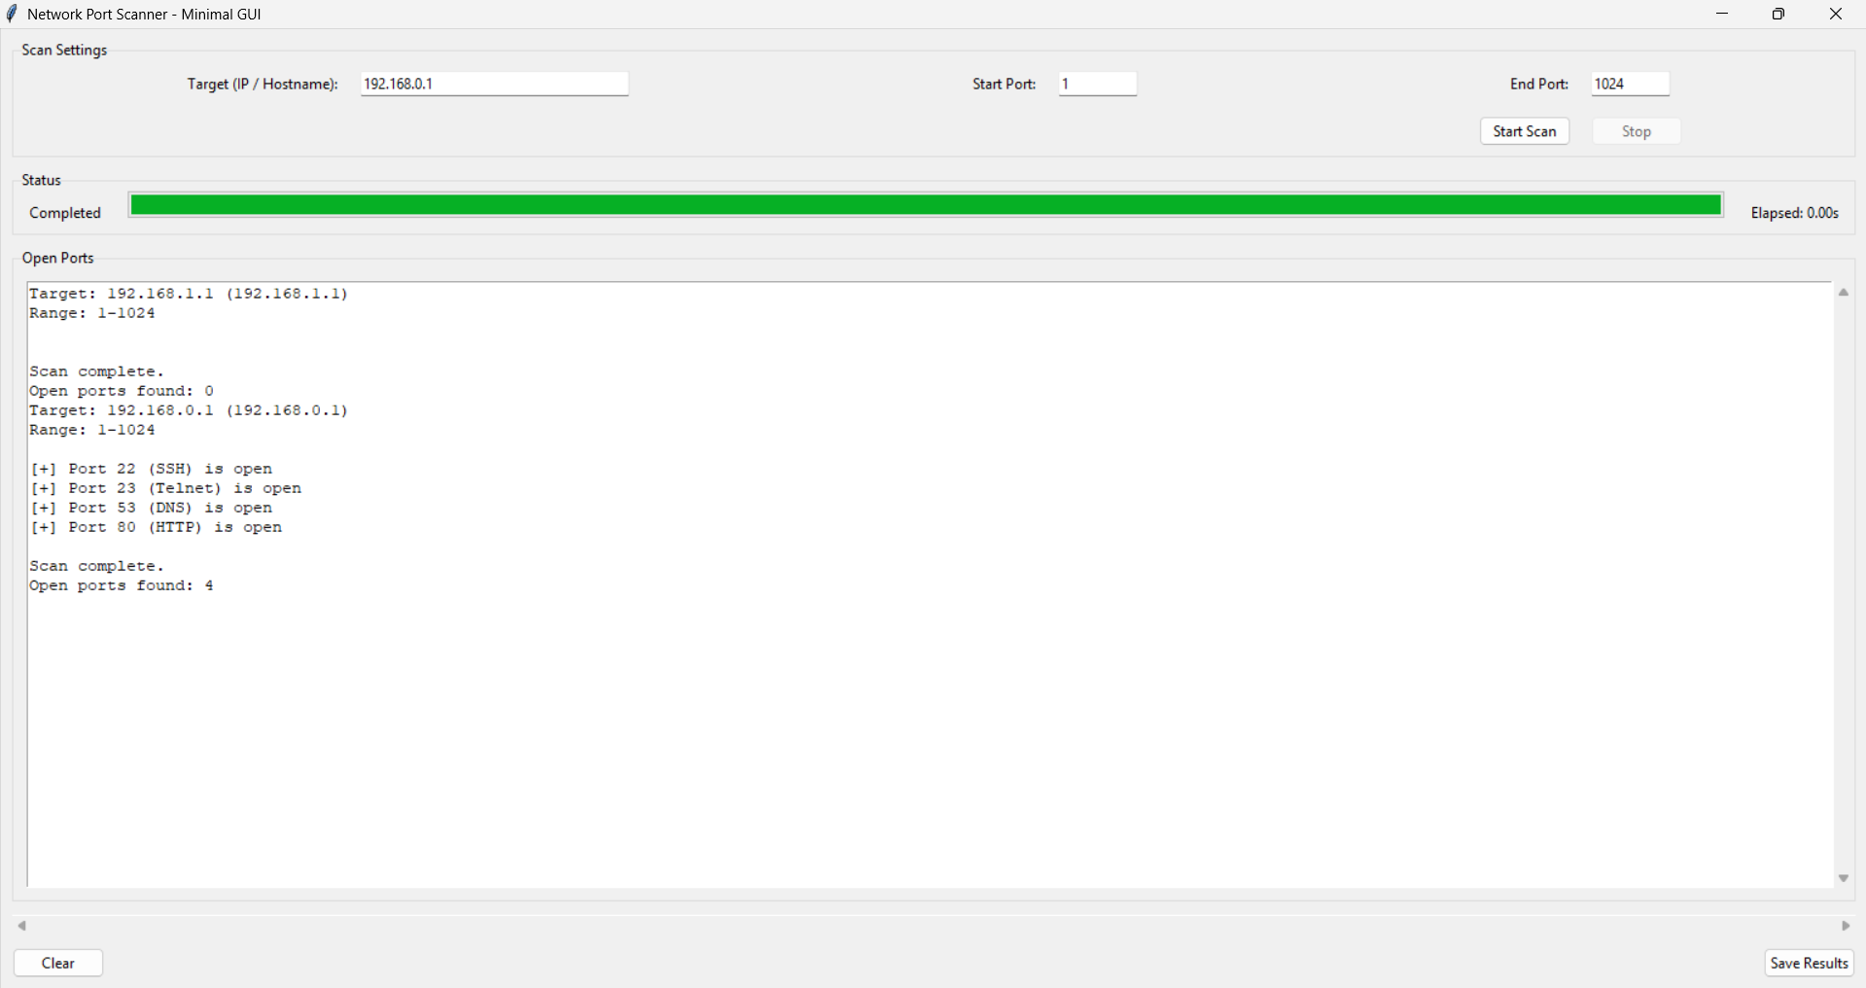
RESULTS

Slide 8
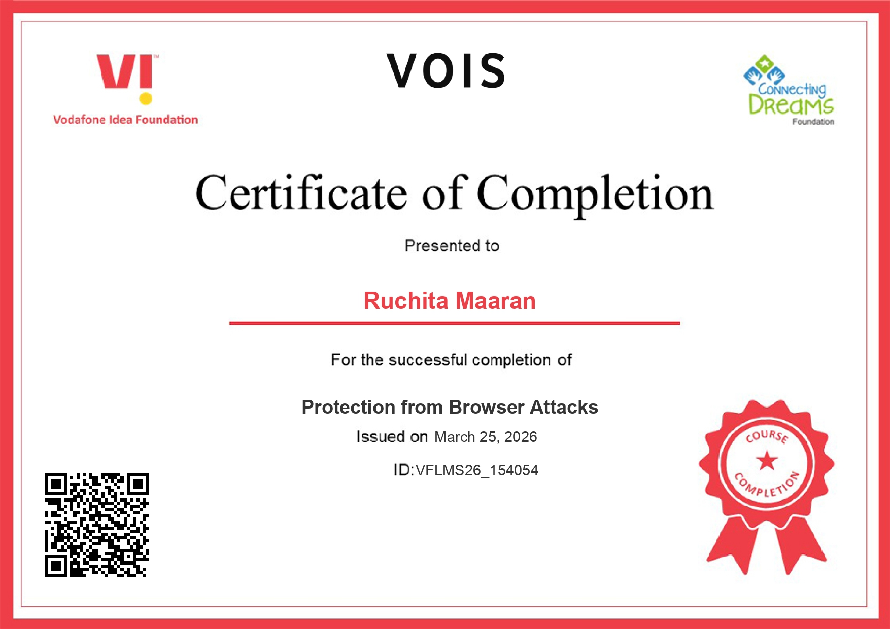
Certificate - Protection from browser attacks

Slide 9

Certificate - Introduction to System Security

Slide 10
GitHub link
https://github.com/WisteriaM7/NETWORK-PORT-SCANNER-GUI

Slide 11
THANK YOU
.
.

